Slide 1
400D saws team results presentation
Presented by Jordan hsu
Hub results update

Slide 2
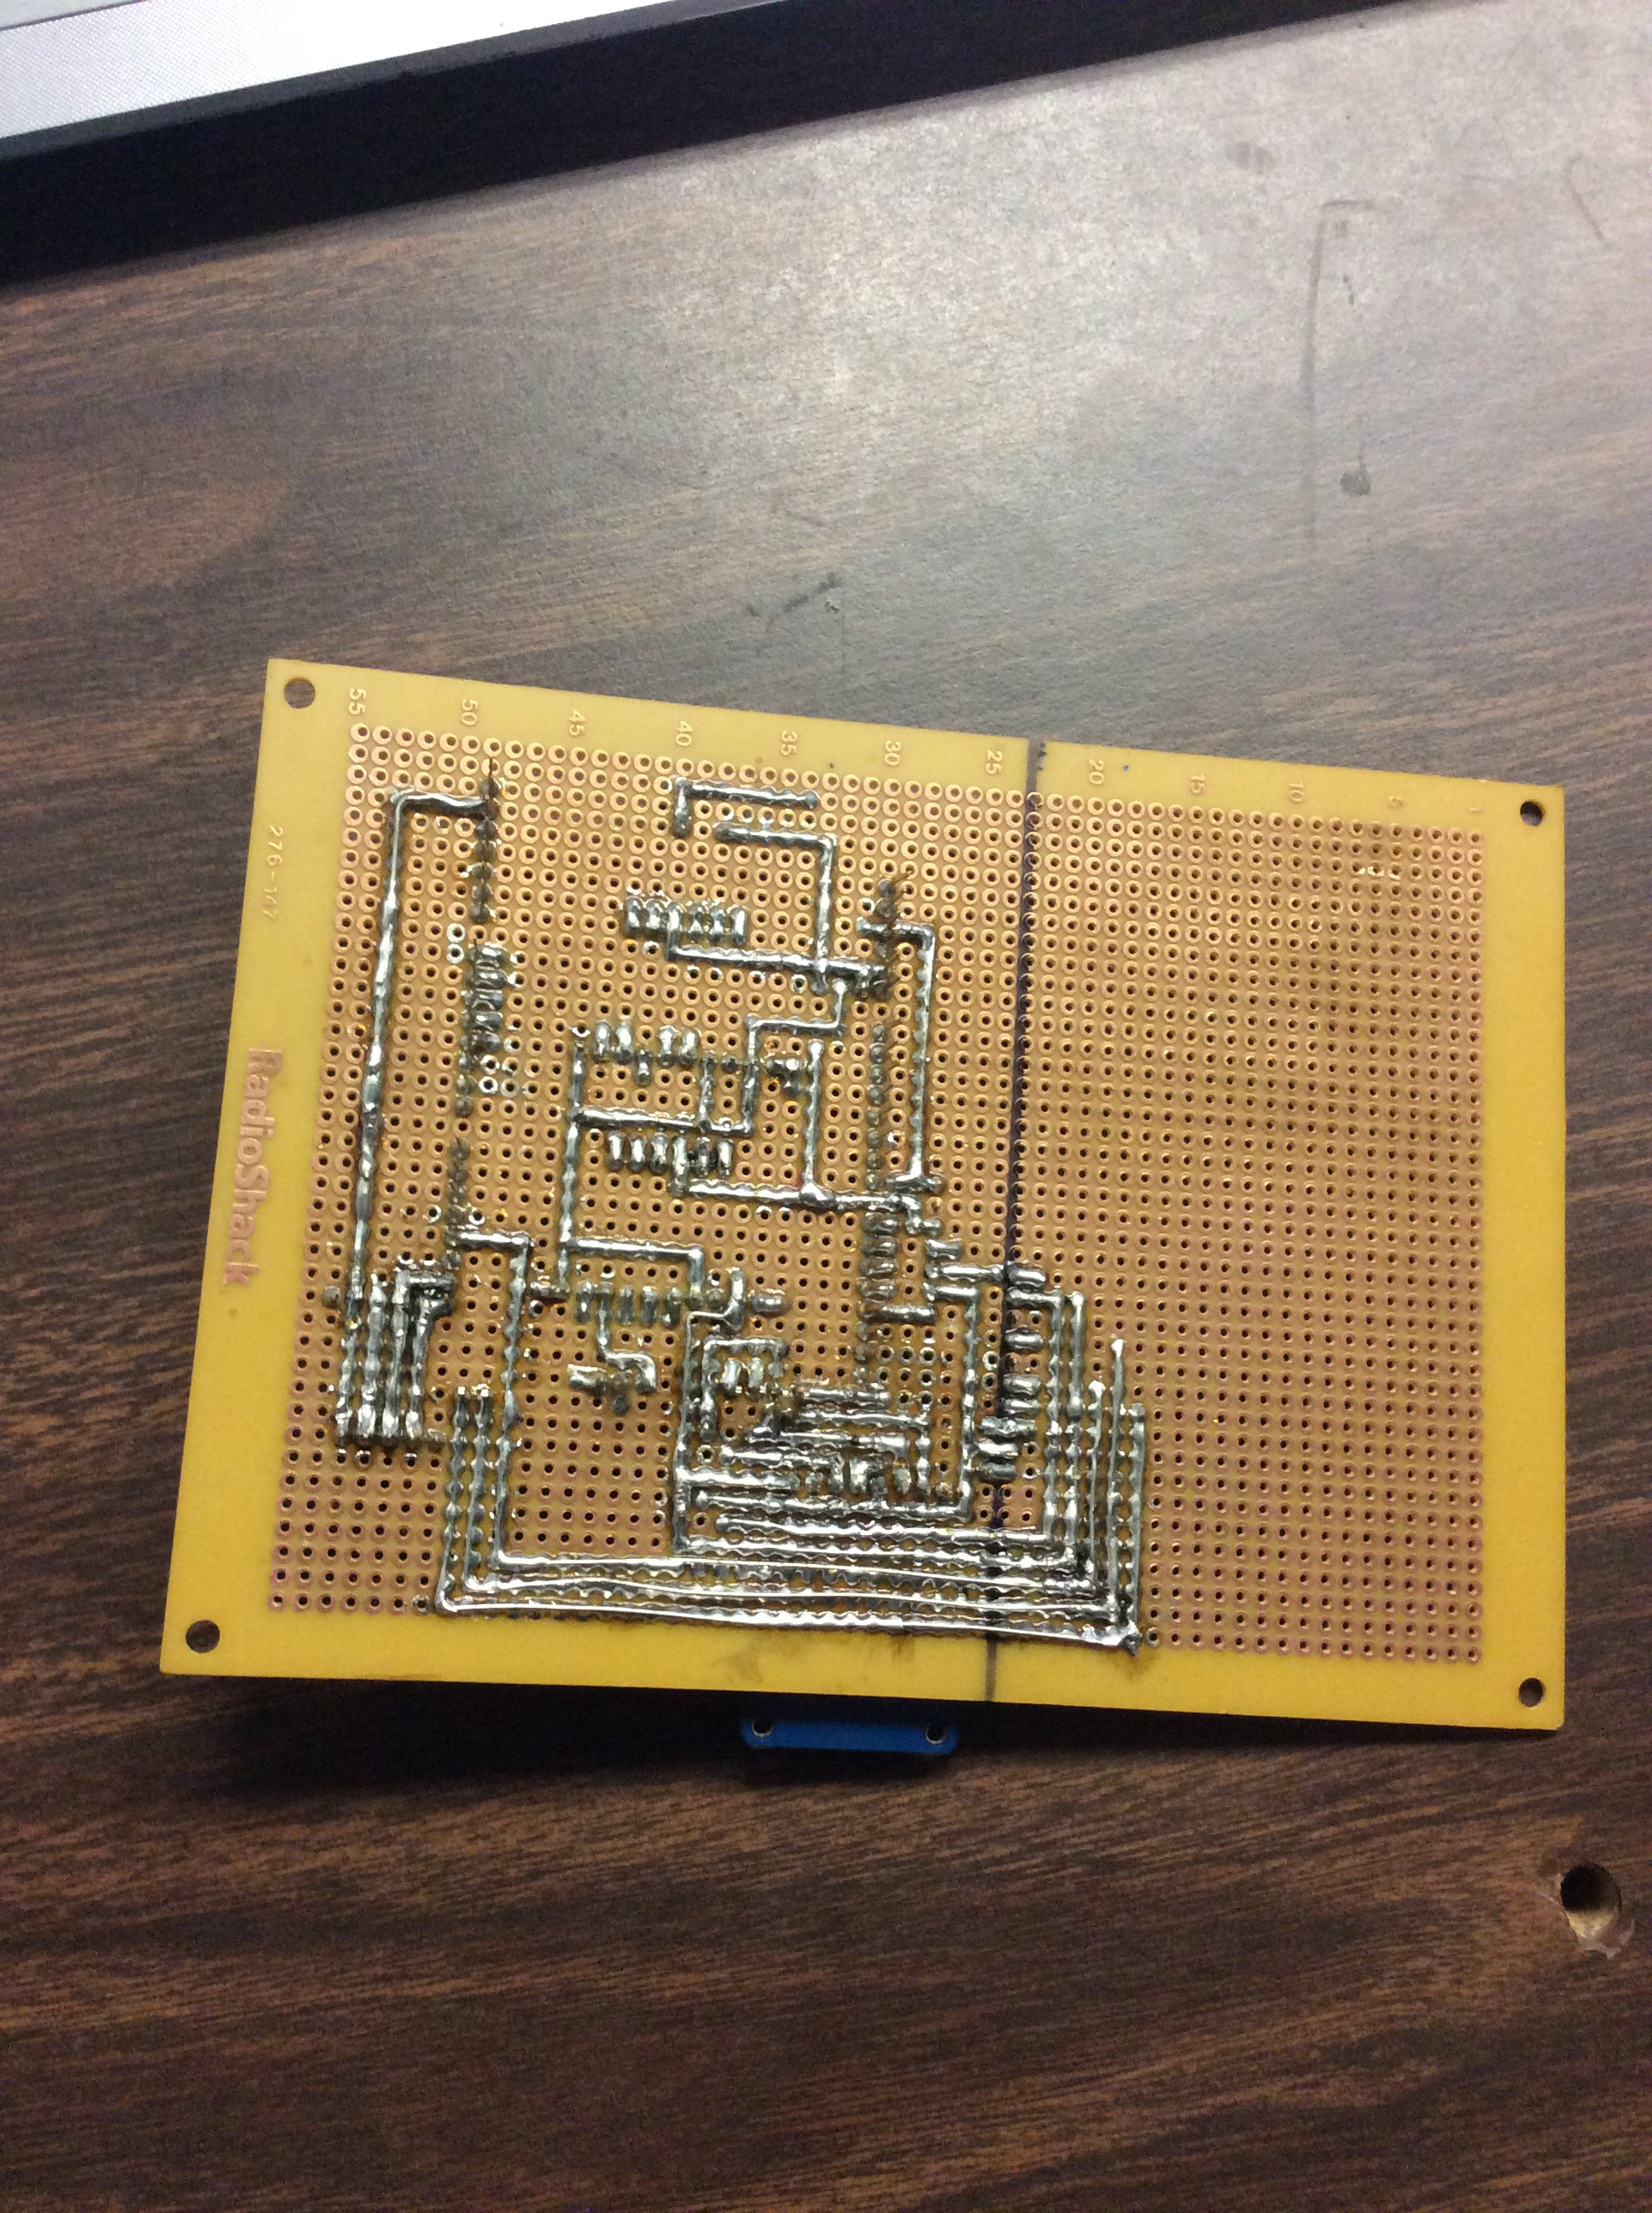
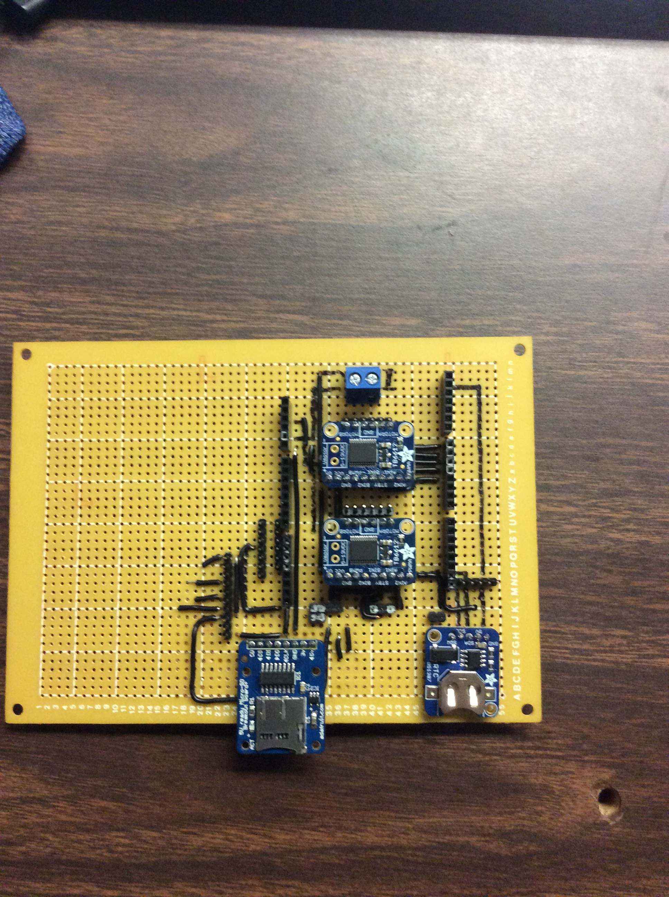
THE HUB
Consists of breakouts for motor driver (x2), real time clock (x1), and an μSD card reader (x1)
Includes pin for externally mounted sensors: UV, humidity/temperature/pressure, and photo sensor
Includes a motor voltage input

Slide 3
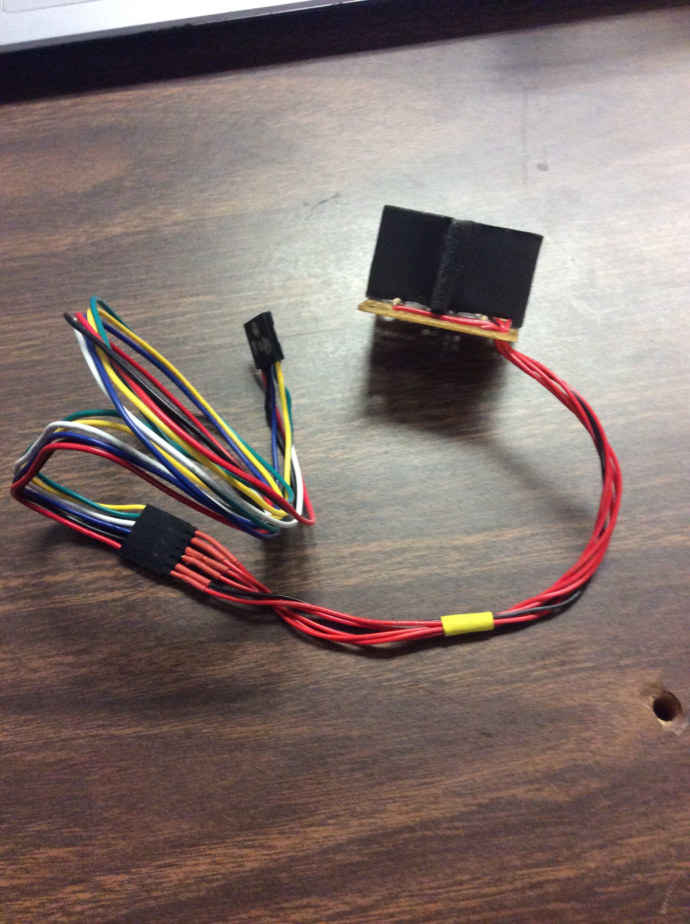
Issues Encountered
Needed to find ways to connect the externally mounted sensors to the hub
Need to make sure the connections from the externally mounted sensors do not get tangled when the panel rotates

Slide 4
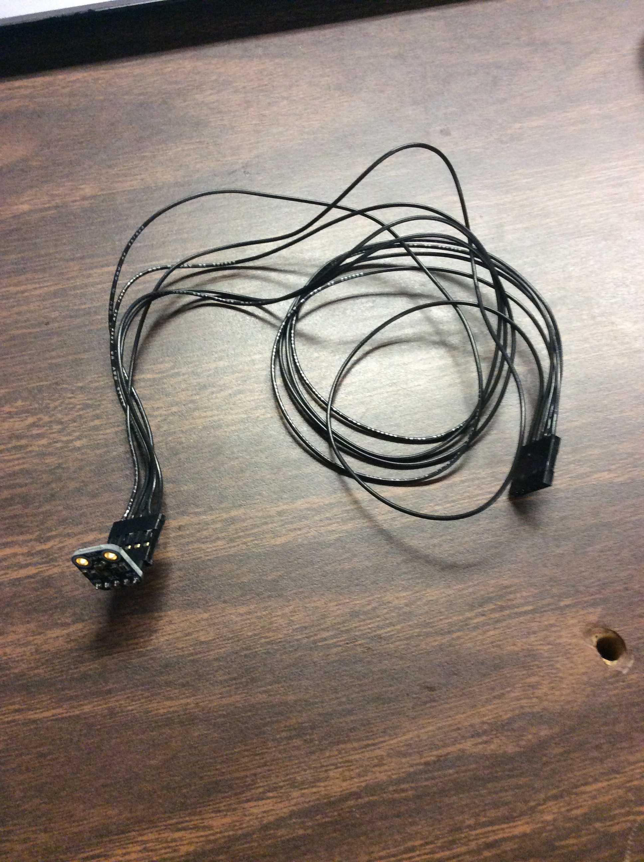
Solutions
Decided to create our own wires, the standard ones found were too short
Some wires are stranded, while the others were solid (ran out of stranded wires)

Slide 5
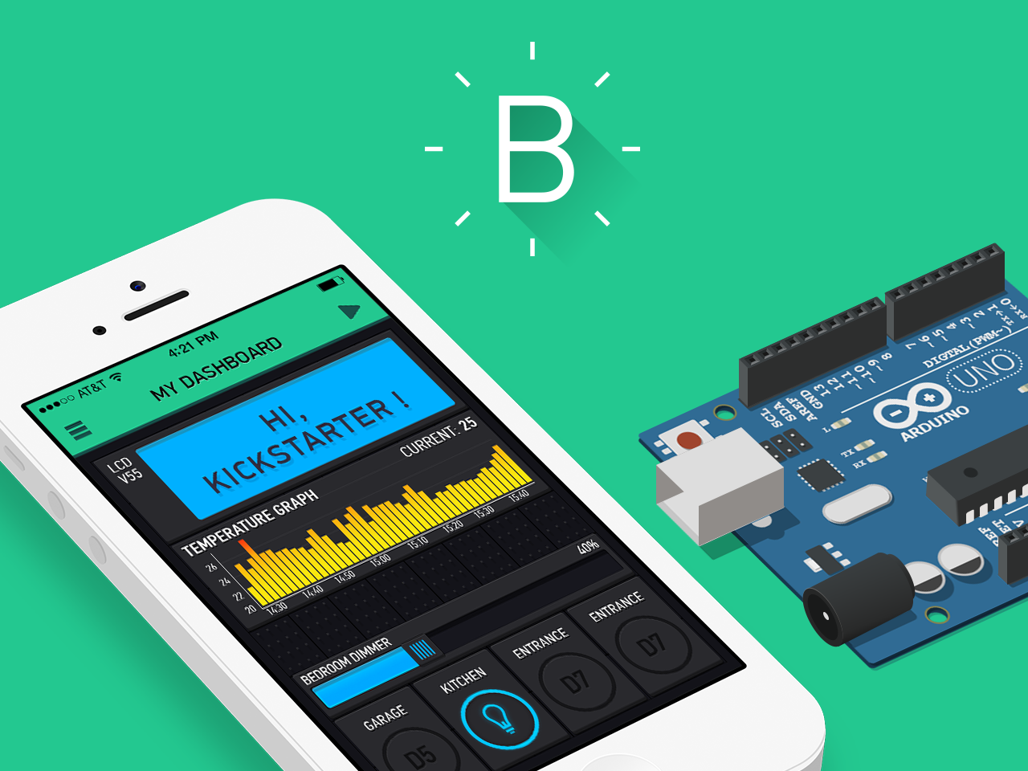
In progress
Currently we are working on implementing an app (Blynk) that can receive sensor data from our Bluetooth device
How Blynk works

